Slide 1

House Price Prediction
Asma Dalil

Slide 2
Content
Introduction
Data Exploration
Feature Selection
Models
Linear Regression
Random Forest Regressor
Model improvement
Notes:
Exploratory Data Analysis (EDA) to understand variable distributions and relationships, data preprocessing to handle missing data and encode categorical variables and feature engineering to enhance model performance. A variety of regression models such as Linear Regression, Ridge Regression, and Random Forest are explored to select the best performer based on metrics and interpretability. The final steps involve evaluating the models to select the most effective one, interpreting model coefficients or feature importances to understand the driving factors of housing prices,

Slide 3
Introduction
Project Overview: Predict housing prices using regression analysis on a dataset ideal for those new to regression but aiming to deepen their understanding.
Dataset Value:
Targets individuals familiar with basic regression, ready for advanced exploration.
Enhances decision-making in real estate investments through a deeper understanding of market dynamics.
Problem Statement:
Tasked with forecasting house prices based on multiple factors such as area, bedrooms, and location proximity.
Addressed challenges like small dataset size and strong multicollinearity among variables.
Project Justification:
Real-world relevance: Housing market dynamics significantly influence economic activities.
Applied advanced analytical techniques on a complex, real-world dataset for predictive modeling.
Notes:
the "Housing Price Prediction" project is designed to predict housing prices using different factors . . The dataset used includes a variety of variables such as area, number of bedrooms, and amenities, introducing real-world.
This project on predicting housing prices is an excellent case for data analysis, prediction, and forecasting due to its real-world relevance and complexity.
It aims to develop models that utilize both evaluating these models using metrics such as R-squared and Root Mean Squared Error (RMSE) to identify the most effective predictors.

Slide 4
Data Exploration
This dataset offers a detailed look into the housing market, encompassing a variety of property-related characteristics such as price, area, and number of bedrooms. Upon importing the data and examining the first few records, it was clear that the dataset is well-structured, with several columns indicating both numerical and categorical attributes. We have around 545 entries and numerous features to work with. A preliminary assessment using the info() method revealed comprehensive information on each column's data type and non-null values, suggesting minimal missing data which was confirmed through a targeted check for null values, yielding no missing entries.
Moreover, no significant issues with duplicate entries were observed, enhancing the dataset's reliability for analysis. Descriptive statistics provided a solid foundation for understanding typical property values, areas, and room configurations. To visually grasp the distribution of key variables like price and area, we plotted histograms which highlighted the variability and skewness in these financial and spatial dimensions. This dataset is not only ready for deeper statistical analysis and modeling but also robust enough to support reliable inferences about housing market trends.
Notes:
Despite its small dataset size, the dataset offers a detailed look into the housing market.
the dataset is well-structured, with several columns indicating both numerical and categorical attributes. We have around 545 entries and numerous features to work with.
Affter assessigg the dataset , there were no missing values, no duplicated entries So This dataset is not only ready for deeper statistical analysis and modeling but also robust enough to support reliable inferences about housing market trends.

Slide 5
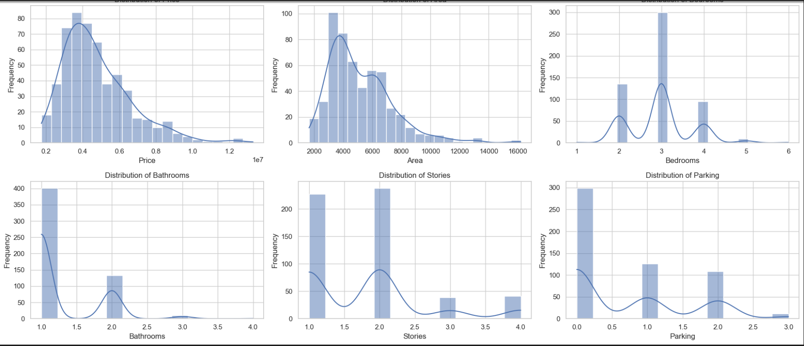
- Numerical variables:
visualization
Price: The price of the house.
Area: The square footage of the property.
Bedrooms: The number of bedrooms in the house.
Bathrooms: The number of bathrooms.
Stories: The number of stories or levels in the house.
Parking: The number of parking spaces available.
The response variable is the price of the house.
This is the target variable
Notes:
The response variable (the variable you are trying to explain or predict) is the price of the house. This is the target variable. - Explanatory variables (variables used to explain or predict the response variable) can include any other features in the dataset that might influence the price of a house. Potential explanatory variables could include: area, bedrooms, stories, furnishingstatus.
The frequency in the histograms represents the number of occurrences of different values of a variable within the dataset.
The Distribution of Price histogram shows how many properties fall within certain price ranges.
The Distribution of Area histogram displays how many properties have specific sizes measured in square feet.
Other histograms for Bedrooms, Bathrooms, Stories, and Parking show the count of properties that have specific counts of these features.
Let's take a look at the distributions of each numerical variable shown in the histograms:
1. **Distribution of Price**:
- This histogram shows a skewed distribution where most of the house prices are on the lower end, with a few high-priced outliers. The frequency peaks at lower price ranges and gradually decreases as price increases.
These distributions provide insights into the typical characteristics of properties in this dataset. For example, most homes are more affordable with smaller areas, have 2-3 bedrooms, 1-2 bathrooms, and 1-2 parking spaces, usually spread over 1 or 2 stories.
2. **Distribution of Area**:
- The area distribution also appears skewed. There is a peak in smaller areas with a long tail extending to larger areas, indicating a few properties with very large areas compared to the majority.
3. **Distribution of Bedrooms**:
- The bedroom count distribution displays a modal peak around 2-3 bedrooms, which is common for average family homes. Few properties have more than 5 bedrooms, as shown by the much lower frequencies for higher bedroom counts.
4. **Distribution of Bathrooms**:
- This graph shows that the most common number of bathrooms is between 1 and 2, with a peak at exactly 2. The frequency of homes with more than 3 bathrooms is significantly lower, suggesting that more bathrooms are less common.
5. **Distribution of Stories**:
- The story count is predominantly 1 or 2, which is typical for residential buildings. There are few homes with 3 or more stories, as indicated by the significantly lower frequencies for higher counts.
6. **Distribution of Parking**:
- The parking space distribution shows that most homes have either 1 or 2 parking spaces. There's a noticeable drop in the frequency of homes with more than 2 parking spaces, indicating that larger parking facilities are uncommon.
These distributions provide insights into the typical characteristics of properties in this dataset. For example, most homes are more affordable with smaller areas, have 2-3 bedrooms, 1-2 bathrooms, and 1-2 parking spaces, usually spread over 1 or 2 stories.

Slide 6
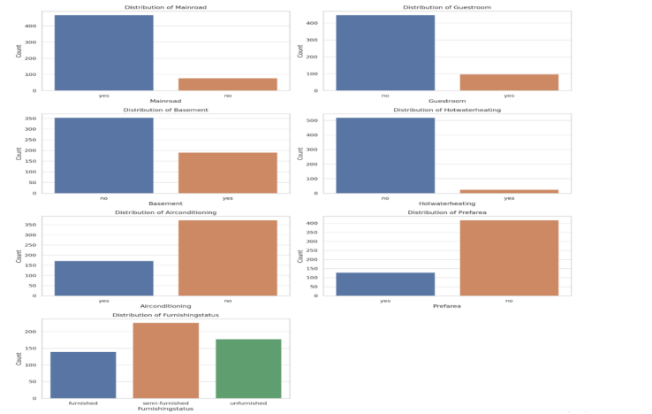
Categorical variables
Mainroad: Indicates if the house has access to a main road (Yes or No).
Guestroom: Specifies whether there is a guestroom (Yes or No).
Basement: Specifies whether the house has a basement (Yes or No).
Hotwaterheating: Indicates if the house is equipped with hot water heating (Yes or No).
Airconditioning: Shows whether the house has air conditioning (Yes or No).
Prefarea: Denotes if the house is located in a preferred area (Yes or No).
Furnishingstatus: Details the furnishing status of the house
(likely categories such as, Semi-furnished, Unfurnished Furnished)
Notes:
The provided chart displays distributions for various categorical features related to housing. Here's a breakdown:
Distribution of Mainroad:
The majority of properties have access to a main road. This is a desirable feature as it often means better accessibility and potentially higher property value.
Distribution of Basement:
More properties do not have a basement than those that do. Basements can be valuable depending on their usability and finish.
Distribution of Airconditioning:
Properties without air conditioning slightly outnumber those with air conditioning. In regions with warmer climates, having air conditioning can significantly affect property value.
Distribution of Guestroom:
Few properties have a guestroom, suggesting that this might be a premium feature that could increase a property's value.
Distribution of Hotwaterheating:
Most properties do not have hot water heating, which might indicate either a warmer climate or that this feature is not standard in the area.
Distribution of Prefarea:
More properties are not in a preferred area than those that are. Properties in preferred areas likely command higher prices due to their desirable location.
Distribution of Furnishingstatus:
The furnishing status is fairly evenly distributed among furnished, semi-furnished, and unfurnished, indicating diverse buyer preferences and potential influence on pricing. Furnished homes might be priced higher due to less required investment after purchase.
Regarding the "yes/no" variables, they are a type of binary categorical variable used to indicate the presence or absence of a feature. Such simplicity in data representation makes it easier to analyze and model these variables statistically. They provide clear dichotomies that can be readily incorporated into various statistical models to understand the impact of having or not having a particular feature on house prices.

Slide 7
Feature Selection:
Filtering Numerical Data: Only numerical columns are considered because correlation coefficients require continuous data.
Computing the Correlation Matrix
Selecting Features Based on Correlation with 'Price': Features that have a significant correlation (greater than 0.3 in absolute value) with the price are chosen. This threshold helps ensure that only features with a moderate to strong linear relationship with price are included, improving model relevance and efficiency.
Notes:
**Correlation Analysis** is a method used to evaluate the degree to which two variables are related to each other. In statistical terms, it quantifies the strength and direction of a linear relationship between two variables. This is usually measured by a correlation coefficient,. The coefficient ranges from -1 to +1, where:
- +1 indicates a perfect positive linear relationship,
- -1 indicates a perfect negative linear relationship,
0 indicates no linear relationship.
This can simplify the model by eliminating features that are unlikely to contribute to the model’s predictive power, reducing complexity and potentially enhancing model performance.

Slide 8
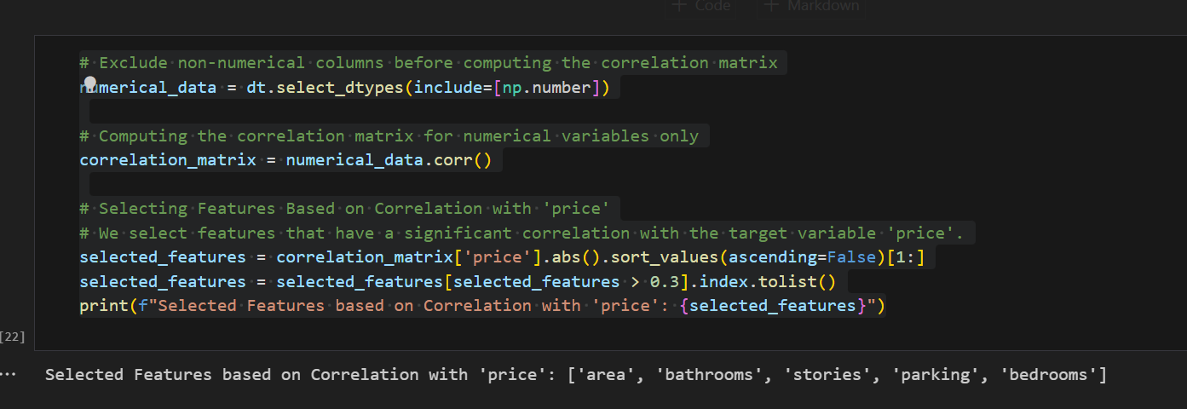
Area, bathrooms, stories, parking, and bedrooms have a significant correlation with the price of a house. This suggests these features are important predictors of house price and should be included in the model.
Features like these, which show a strong correlation, are likely to have a greater impact on the model's prediction accuracy for house prices.
Notes:
Usage in the Code
Extracting Numerical Data: The code first isolates the numerical columns of a dataset using dt.select_dtypes(include=[np.number]). This is to ensure that correlation calculations are only performed on quantitative data.
Computing the Correlation Matrix: The correlation matrix is computed with numerical_data.corr(). This matrix includes the correlation coefficients between all pairs of the numerical features in the dataset.
Feature Selection Based on Correlation with Price: The code focuses on selecting features based on their correlation with the target variable, which is price in this instance. It:
Retrieves the correlation coefficients relative to price from the matrix.
Filters out the features where the absolute value of the correlation coefficient is less than 0.3, indicating a weak linear relationship.
The cutoff value of 0.3 is chosen arbitrarily and can be adjusted depending on the specific requirements or sensitivity analysis of the problem at hand.

Slide 9
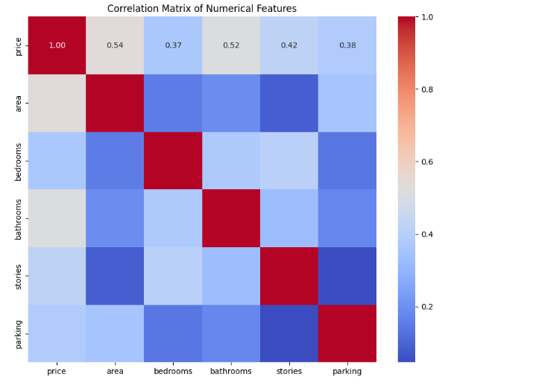
Visulization
Correlation Matrix
Notes:
Price and Area (0.54): A moderately strong positive correlation of 0.54 suggests that larger homes tend to be priced higher.
Price and Bedrooms (0.37): A moderate positive correlation suggests that a higher number of bedrooms generally leads to higher prices.
Price and Bathrooms (0.52): A stronger positive correlation compared to bedrooms, indicating that more bathrooms significantly increase the house price, possibly more so than the number of bedrooms.
Price and Stories (0.42): This positive correlation shows that houses with more stories tend to be priced higher.
Price and Parking (0.38): Moderately positive, indicating that more parking space is associated with higher house prices.
The image you've provided appears to be a correlation matrix visualized as a heatmap. Here's how to interpret this:
### What the Colors Refer To:
- The colors in the heatmap range from red to blue. The color scale on the right indicates that red represents higher positive correlation values (closer to +1.0), and blue represents lower negative correlation values (closer to -1.0). Lighter shades, moving towards white, indicate correlation values closer to zero, suggesting no or very weak linear relationship.
### What the Numbers Refer To:
- Each cell in the matrix has a number that represents the Pearson correlation coefficient between the two variables corresponding to the row and column of that cell. This coefficient measures the strength and direction of the linear relationship between the variables. For instance:
- **1.00** in the diagonal cells indicates a perfect positive correlation, as every variable is perfectly correlated with itself.
- **0.54** between `price` and `area` suggests a moderately strong positive correlation, meaning that as the area of a property increases, its price tends to increase as well.
### Understanding Specific Parts of the Matrix:
- **Diagonal Cells (e.g., `price` with `price`, `area` with `area`)**: These always show a correlation of 1.00 because a variable is always perfectly correlated with itself.
- **Off-Diagonal Cells (e.g., `price` with `area`)**: These show the correlation between different variables. For example, a correlation of 0.54 between `price` and `area` indicates that larger properties tend to be more expensive.
### Summary of Correlations:
- **`price` and `area`**: A correlation of 0.54 suggests that larger homes tend to be priced higher.
- **`price` and `bedrooms`**: A correlation of 0.37 indicates a moderate relationship, where more bedrooms may correspond to higher prices.
- **`price` and `bathrooms`**: A correlation of 0.52 shows a strong positive relationship, suggesting that properties with more bathrooms tend to have higher prices.
- **`price` and `stories`**: A correlation of 0.42 indicates a moderate to strong relationship, where properties with more stories might be more expensive.
- **`price` and `parking`**: A correlation of 0.38 suggests that homes with more parking spaces are likely to be more expensive.
### Usage:
This kind of matrix is crucial for understanding interrelationships between variables in a dataset, particularly in preparing for modeling tasks. By identifying which variables are strongly correlated with the target variable (`price` in this case), you can select relevant predictors for building a predictive model. Also, it helps in identifying multicollinearity, which might necessitate adjustments in model design to avoid redundant or overly influential variables.

Slide 10
Models: linear regression
Linear Regression is a statistical approach for modeling the relationship between a dependent variable and one or more independent variables using a linear equation. The model aims to fit a line that minimizes the sum of squared differences between the observed values and the predicted values provided by the linear equation. In simple terms, it predicts the value of a variable based on the values of other variables, with the coefficients representing the weight that each independent variable has on the dependent variable.
Notes:
Linear regression is a way to predict a number based on other numbers. Imagine you want to predict the price of a house. You might look at things like the size of the house, how many bedrooms it has, and so on. Linear regression takes these features and creates a formula that can predict the house's price by combining these features in a specific way.

Slide 11
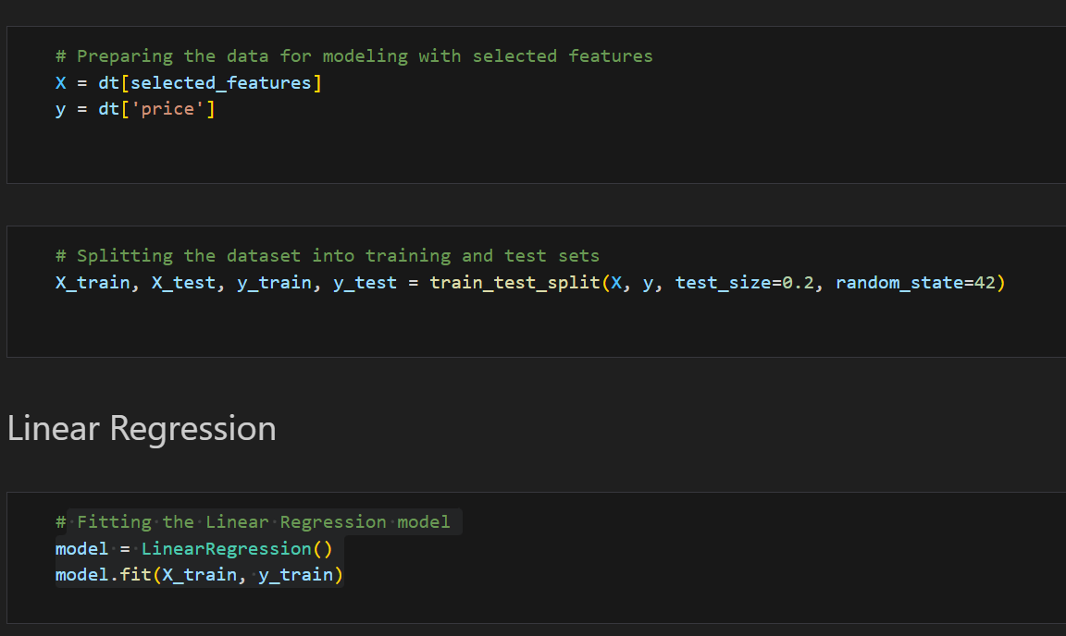
Features with stronger correlations are typically prioritized for model training.
It is helping to identify the most impactful variables for inclusion and ensuring the creation of more accurate and reliable models.

Slide 12
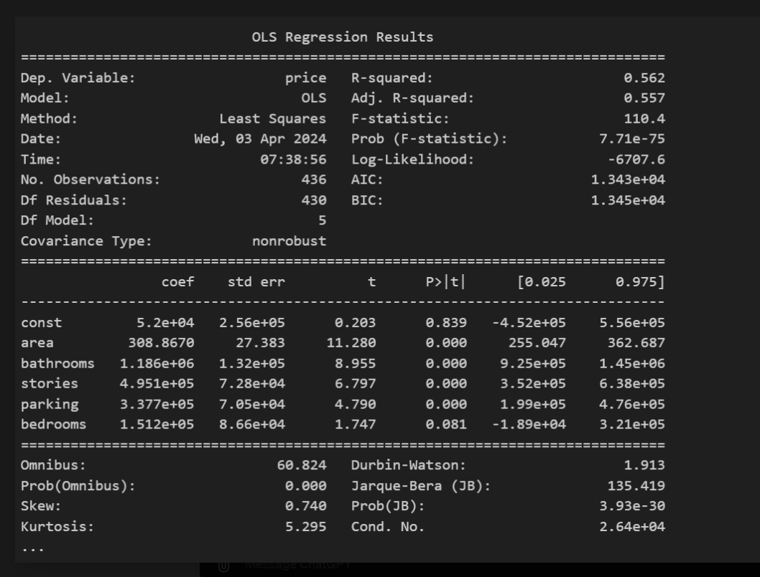
Results
Prediction: The output from model.score(X_test, y_test) gives an (R²) value of approximately 0.546.
Practical Usability: While the model is moderately effective, decisions on its practical application should consider the acceptable thresholds for model performance in the specific context or industry.
Adjusted R-squared (0.557): Adjusts the R-squared for the number of predictors in the model, providing a more accurate measure in the context of multiple variables.
F-statistic (110.4): Tests whether at least one predictor variable has a non-zero coefficient. The associated p-value (7.71e-75) suggests the model is statistically significant.
P-values for coefficients: All variables except bedrooms have p-values less than 0.05, indicating that they are significant predictors of the price.
Notes:
Potential for Improvement: The outcome suggests there might be room for improving the model. This could be achieved by adding other potentially relevant features, using a different kind of regression model that captures non-linear relationships if appropriate, or addressing any data quality issues or outliers that may be impacting model performance.
Dep. Variable (Dependent Variable): The variable that the model is trying to predict, in this case, 'price'.
R-squared: Measures the proportion of variance in the dependent variable that can be predicted from the independent variables. Here, 0.562 indicates that 56.2% of the variance in house prices can be explained by the model.
Adj. R-squared (Adjusted R-squared): Similar to R-squared but adjusted for the number of predictors in the model. It is more accurate for comparing models with different numbers of predictors.
F-statistic: Tests whether at least one predictor variable has a non-zero coefficient. The F-statistic is quite large at 110.4. This suggests that the model is statistically significant,
Prob (F-statistic): The probability of the F-statistic, indicating the overall significance of the regression model. It is extremely close to zero that suggests the model is statistically significant
Log-Likelihood: A measure of the fit of the model. Higher values indicate a better fit.
AIC (Akaike Information Criterion) and BIC (Bayesian Information Criterion): These are criteria for model selection among a finite set of models; lower values suggest a better model.
Coefficients Table
coef (Coefficient): Represents the change in the dependent variable for a one-unit change in the predictor, For every one-unit increase in the area of a house ; he price of the house is expected to increase by approximately 308.87 units of currency.
std err (Standard Error): Measures the accuracy of the coefficients; lower values indicate more precise estimates.
t: The t-statistic for testing the null hypothesis that the coefficient equals zero (no effect).
P>|t| (p-value): Probability of observing any value equal or larger than t. A p-value less than 0.05 typically means the coefficient is statistically significant. Eg The p-value associated with this coefficient is less than 0.001, which indicates that the result is highly statistically significant.
[0.025 0.975]: The 95% confidence interval for the coefficient. If this interval does not contain zero, the coefficient is likely to be significant.

Slide 13
Random Forest Regressor
The RandomForestRegressor is a type of ensemble machine learning algorithm that is part of the broader family of Random Forest algorithms. It's specifically used for regression tasks, where the goal is to predict a continuous outcome variable.
Notes:
The Random Forest Regressor is a type of ensemble learning algorithm used in regression tasks, which involves predicting continuous values, like house prices
It builds upon the concept of decision trees and utilizes the power of multiple such trees to improve prediction accuracy and control over-fitting.
Model Concept: The model builds multiple decision trees during training. Each tree makes a prediction of the house price. The final prediction is typically the average of all the tree predictions.

Slide 14
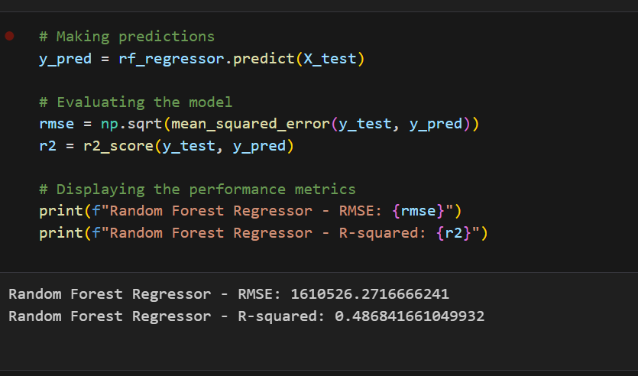
Results:
The Random Forest Regressor model's output, showing an RMSE of 1,610,526 and an R-squared of 0.4868, indicates that the model has moderate predictive accuracy.
The RMSE value is relatively high, suggesting that the model's predictions can deviate significantly from actual values, which might affect its practical applicability depending on the precision needed. The R-squared value suggests that nearly half of the variability in the target variable is explained by the model, which is decent but also highlights room for improvement.
Notes:
RMSE (1,610,526.27): This high RMSE value relative to a small dataset might indicate that the model predictions deviate significantly from the actual values. the range of house prices in the dataset is not extraordinarily high, this RMSE is a sign of poor model performance.
R² (0.4868): An R² value under 0.5 in a regression model indicates moderate predictive power, which might not be satisfactory for many practical applications. This suggests that the model, as currently configured, might not be adequately capturing the data's underlying trends.
highlights room for improvement.

Slide 15
Model Improvement
Tuning the hyperparameters of the Random Forest model more extensively, perhaps by using grid search or random search to find a better combination.
Handling any potential outliers or skewed distributions in the dataset that could be affecting model performance.
Using a more sophisticated ensemble method or trying different algorithms that may capture the complex patterns in the data better.
Regularization Techniques: To prevent overfitting, especially in complex models like Random Forest, regularization methods such as Lasso, Ridge, or Elastic Net might be applied. These techniques penalize the loss function by adding a complexity term that depends on the model coefficients.
Notes:
This could involve enhancing the model by adding more relevant features, tuning hyperparameters, or trying different modeling approaches to better capture the underlying data patterns.
Feature Engineering: Try to create new features from the existing data or transform them in ways that might expose new patterns to the model.
Model Tuning: Adjust Random Forest parameters (like the number of trees, max depth, min samples split, and min samples leaf) to see if the model performance can be improved.
Cross-validation: Employ cross-validation techniques to ensure that the model's performance evaluation is robust and not overly dependent on the particular split of training and test data.
Incorporate More Data: If possible, adding more data could be beneficial. More data would provide a more comprehensive basis for the model to learn from, potentially improving both the accuracy and the generalization of the model.

Slide 16


